Slide 1
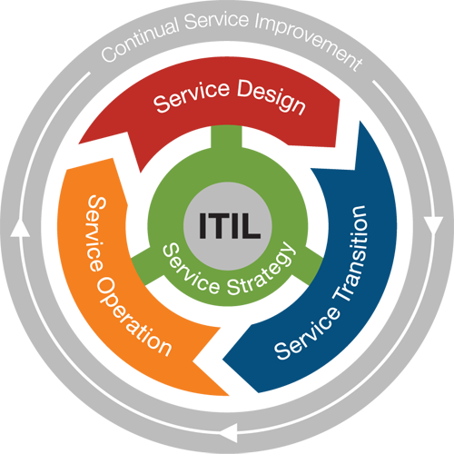
ITSM
Incident Management
Incident Management
is a process in Service Operation lifecycle module of ITIL

Slide 2
Incident Management Definition
Incident (definition):
An unplanned interruption of an IT service or a reduction in the quality of IT services.
Error in a configuration item that has not yet impacted the service.
For example, there are errors on one of several mirrored disks.

Slide 3
Configuration Item (CI)
Configuration Item (CI)
Configuration Items refers to the Fundamental Structural Devices of the Configuration Management Database (CMDB) (Configuration Management System (CMS))
CI’s can be:
Hardware
Software
Communications/Networks
Locations
Documentation
People (Staff and Contractors)

Slide 4
Incident Management
Incident Management is an IT service management process:
Responsible for restoring the IT service to workingstate quickly as possible, in case any
Common Incident Examples
Although there are endless reasons users contact the Service Desk for assistance:
Active Directory password reset
Delete Active Directory account
Error message when trying to launch or access an application
Printer not printing
Hardware – printer, fax, scanner, tablet not working

Slide 5
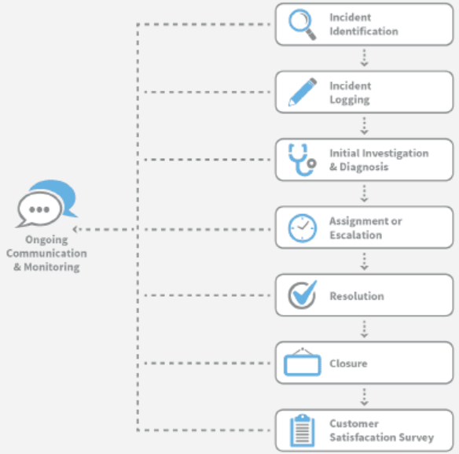
Incident Management Process (Lifecycle)
Incident Management process manage Incidents reported automatically by an event management tool, by users or service desk technicians via a self-service portal, over the telephone, email or in person.
The Incident Management lifecycle includes:
1) Incident identification
Ideally Incidents are identified at a very early stage
through automated event monitoring tool, even before it
impacts a user. However, this isn’t always the case.
Sometimes Incidents are identified by the impacted user
reporting it to the service desk.
2) Incident logging
In order to maintain a complete historical record, all
Incidents must be logged with all relevant details,
including date/time, user information,
description, related Configuration Item
Incident investigation and diagnosis
This step takes place immediately in order to determine the best course for correction.
The technician may rely on the knowledge base, or known errors for diagnosis and/or resolution.

Slide 6
Incident Management Process (Lifecycle)
4) Incident assignment or escalation
Initially, the service desk technician attempts to resolve the Incident.
However, if the service desk is unable to provide resolution, the Incident is escalated to the appropriate level of support, possibly involving either second- or third-level technical support staff who possess the skills to resolve the Incident.
5) Incident resolution
Once resolved, the solution can be implemented and tested to confirm service recovery.
6) Incident closure
Following confirmation that the Incident has been resolved, and the end-user is satisfied and in agreement, the Incident can be closed.
The service desk technician should ensure that the initial classification details are accurate for future reference and reporting.
7) User satisfaction survey
A user satisfaction survey may be utilized to determine overall satisfaction with their service delivery.
This is one of the most effective ways to build and maintain a positive relationship with your customers and users, especially if you pay close attention and implement improvements based on their feedback.
There are several methods for gathering feedback, including after-call surveys, personal telephone surveys and, most commonly, the online survey.

Slide 7
Configuration Item (CI)
Many organizations struggle with defining what should be a configuration item within their Configuration Management Database (CMDB) or Configuration Management System (CMS).
A configuration item (CI) is defined by ITIL as “any component or other service asset that needs to be managed in order to deliver an IT service.
Information about each configuration item is recorded in a configuration record within the configuration management system - CMS.
Configuration Items (CI) are under control of change management.”

Slide 8
Configuration Management System (CMS)
Definition (CMS)
A set of tools and databases used to keep track of a Service Provider's Configuration data.
CMS contains information about Incidents, Problems, Known Errors, Changes and Releases.
CMS can contain data about employees, suppliers, locations, business units, customers and users.
CMS include tools for collecting, storing, managing, updating and presenting data relating to all CIs and their interrelationships.

Slide 9
KPI
% af det samlede antal sager som registreres via end user interface
% af antal af sager som løses inden for aftalt tid fordelt på prioriteter
% af det samlede antal sager hvor brugeren accepterer løsningen første gang
% af de registrerede sager som løses ved første kontakt
% af antal lukkede sager sammenlignet med antal registrerede sager

